Slide 1
Ethical challenges in paediatric research: consent and assent Phaik Yeong Cheah, B.Pharm, MSc (Bioethics), PhD
Professor of Global Health, University of Oxford
Head, Bioethics & Engagement, Mahidol Oxford Tropical Medicine Research Unit
22 July 2022

Slide 2
Village Drama Against Malaria in Cambodia 2016-19
Part of University of Oxford, collaborate with Mahidol University
Core funded by Wellcome Trust
Bangkok hub, but conducting clinical research internationally
Tropical medicine and infectious diseases: Malaria, antimicrobial resistance, maternal and child health, COVID-19
Conduct research studies (clinical trials and non trials), many them include paediatric patients

Slide 3
Should research with children be conducted?
Take a minute to write your thoughts in the chat. Yes or no and why?

Slide 4
Children have historically been excluded from the vast majority of trials.
Seen as vulnerable - need to be protected from research
However, the imputation of information gained from adult studies to the pediatric population is often scientifically and ethically wrong.
Pediatric physiology, disease processes, and the pharmacokinetics of drugs used are likely to be different in children.

Slide 5
Example of a MORU-led ongoing clinical trial with children
Triple artemisinin combination therapy (new treatment) vs artemisinin combination therapy (current treatment using two drugs)

Slide 6
“We should protect children through research not from research”
http://nuffieldbioethics.org/wp-content/uploads/Children-and-clinical-research-full-report.pdf 2015

Slide 7
Elements of valid consent
Information
Comprehension
Voluntariness

Slide 8
Informed Consent for Research
A process by which a subject voluntarily confirms his or her willingness to participate in a particular trial/*research, after having been informed of all aspects of the trial/*research that are relevant to the subject's decision to participate.
(ICH GCP 2016)
*clinical research’ covers an immensely wide range of activity

Slide 9
Assent
The US Code of Federal Regulations: “the IRB must determine that adequate provisions are made for soliciting the assent of the children”
When a potential research subject who is deemed incapable of giving informed consent is able to give assent to decisions about participation in research, the physician must seek that assent in addition to the consent of the legally authorised representative
(Declaration of Helsinki 2013)

Slide 10
Why should assent be sought?
Ethical reasons
Respect for persons
Respect emerging autonomy of the child
Pedagogical reasons
“Capacity for preference”
A child as a rights-holder and active agent in the assent (or informed consent) process
Notes:
the supportive or educational role of parents in helping their child develop and ‘practise’ decision-making skills and confidence.

Slide 11
Instrumental reasons
To obtain cooperation from the child
Children have their own worries that are different from adults – related to missing school, teenage problems, get teased by other kids, stigma, looking cool, boys, girls
Scared of needles etc

Slide 12
Many challenges!

Slide 13
What does assent mean?
Baines P: Assent for children's participation in research is incoherent and wrong. Arch Dis Child 2011

Slide 14
If a child is deemed incompetent and therefore unable to consent to participate in a study….. how is it that he or she can provide “affirmative agreement” or “acquiescence?

Slide 15
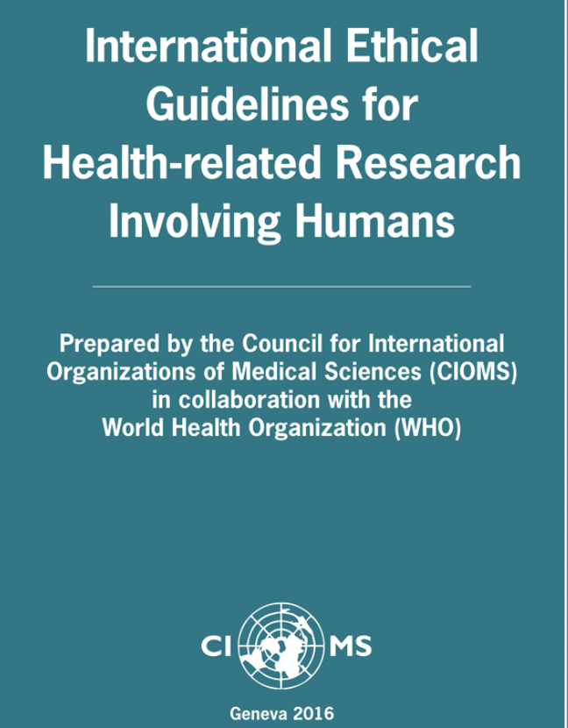
How much information and how to give it?
“..the agreement (assent) of the child or adolescent has been obtained in keeping with the child’s or adolescent’s capacity, after having been provided with adequate information about the research tailored to the child’s or adolescent’s level of maturity” (CIOMS 2016)
There is a spectrum of capacity to understand – difficult to determine, need child psychologists with a battery of tests

Slide 16
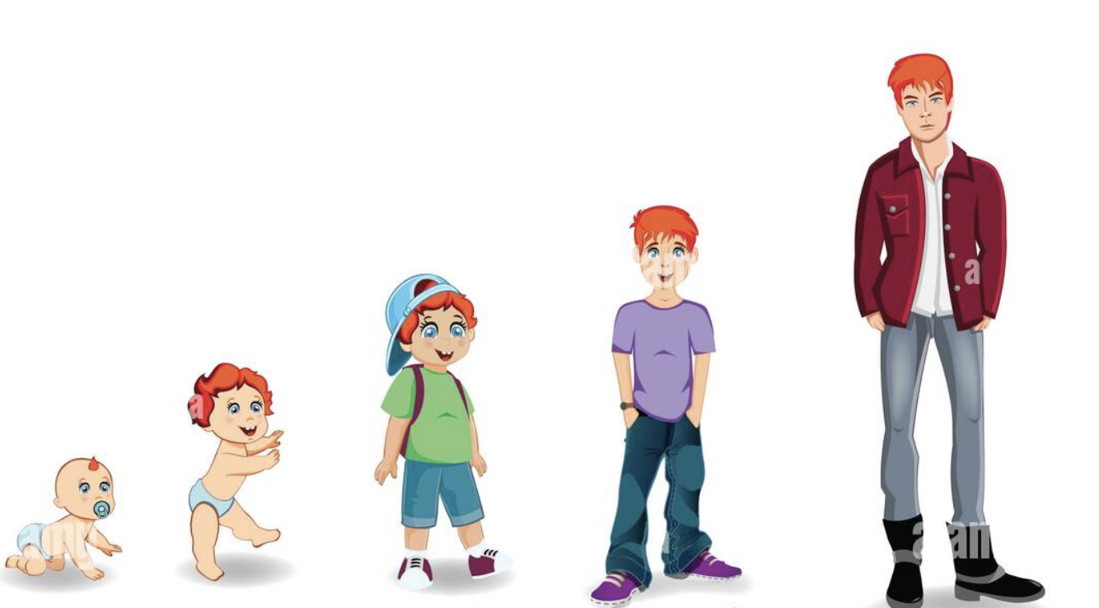
When should assent be sought?
Who is a child? From baby to age of majority
Generally 7-18 years old, and written

Slide 17
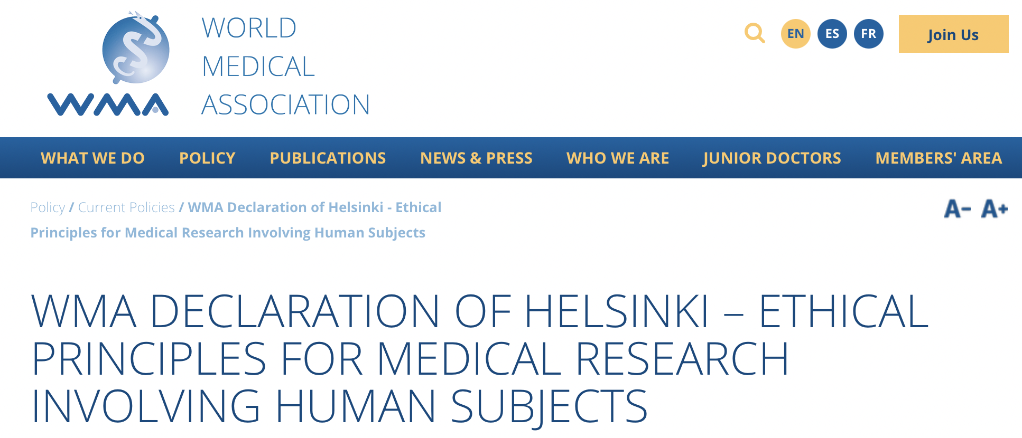
Who should provide proxy consent?
When a potential research subject who is deemed incapable of giving informed consent is able to give assent to decisions about participation in research, the physician must seek that assent in addition to the consent of the legally authorised representative
(Declaration of Helsinki 2013)

Slide 18
Diverse terminology
A wide range of terms are used
Earlier version of DOH – “responsible relative”
legally authorized representative’ (DOH 2013)
legally acceptable representative’ (ICH GCP 2016)
legally designated representative’ (EU)
legal guardian’, ‘parent’ and ‘representative’ etc
with varying levels of legal authority - ‘permission’ (CIOMS 2016), ‘authorisation’ (Oviedo) and ‘informed consent’ (DOH 2013)

Slide 19
Who is this person??
Deference given to application laws – challenging in LMICs, no specific laws on paediatric clinical research (e.g. Thailand, Zimbabwe)
Usually means biological parent/guardian?

Slide 20
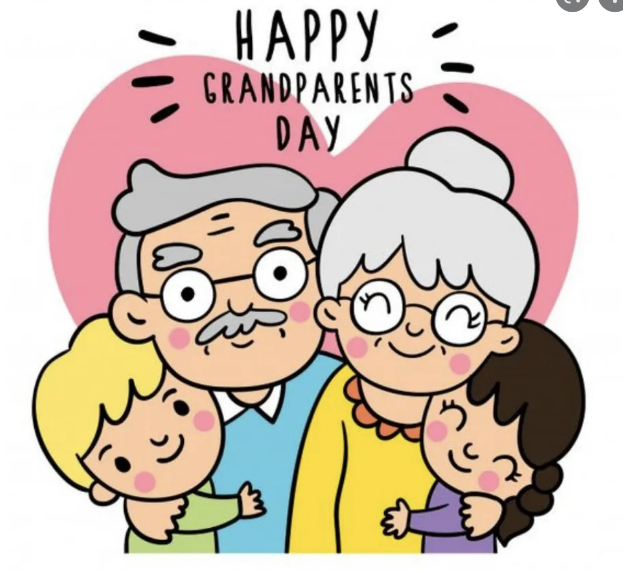
Intergenerational households, grandparents caring the child
Many parents (eg in Thailand, Cambodia) work in the cities, their children are looked after by their grandparents
Orphans
Children of minor parents
Children of parents without legal status (ethnic minority)
Children living without parental care
Leads to presumptive exclusion from clinical research

Slide 21
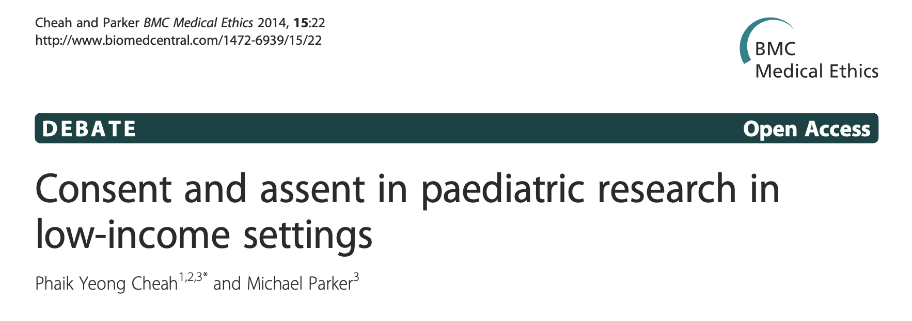
More challenges in low income settings challenges
Local paediatric research guidelines not clear or non existent
Inexperienced personnel conducting paediatric research
Resource starved hospitals need to cope with everyday clinical care

Slide 22
Low level of formal education, literacy and health literacy – both parents & children
Community not familiar with research and consent. Assent?
Community not familiar with signing a document (children NEVER sign anything)

Slide 23
Children do not formally assent for their own (non research) medical care
More parental control (sometimes less)
“Researcher may appear to insult the parent” – physician, Cambodia

Slide 24
Children may be “cleverer” than their parents, more exposed
Some (older) children take adult responsibilities and adult decisions day to day
Some children can consent for themselves
*Gillick competence – mainly for clinical care, not research

Slide 25
When should children consent in their own right?
Competence - the ability to understand and retain relevant information, to weigh or judge the relative merits of the options and to make and communicate a decision
Maturity a prerequisite for making decisions that are more significant in their consequences, involving perhaps substantial changes to a person's life prospects or where the decision may have irreversible effects.
A great deal will depend on the nature of the study
Cheah PY, Parker M. Research consent from young people in resource-poor settings. Archives of Disease in Childhood 2015;100:438-440.

Slide 26
Going forward

Slide 27
Assent vs consent
Case One: children who are not able at this time to contribute their own view as to whether they should take part in research, such as babies and very young children, or children who are temporarily unable to contribute because they are so unwell or are unconscious.
Case Two: children who are able at this time to form views and express wishes, but who are clearly not yet able to make their own independent decisions about research involvement
Case Three: children and young people who potentially have the intellectual capacity and maturity to make their own decisions about taking part in a particular research study, but who are still considered to be minors in their domestic legal system
http://nuffieldbioethics.org/wp-content/uploads/Children-and-clinical-research-full-report.pdf 2015

Slide 28
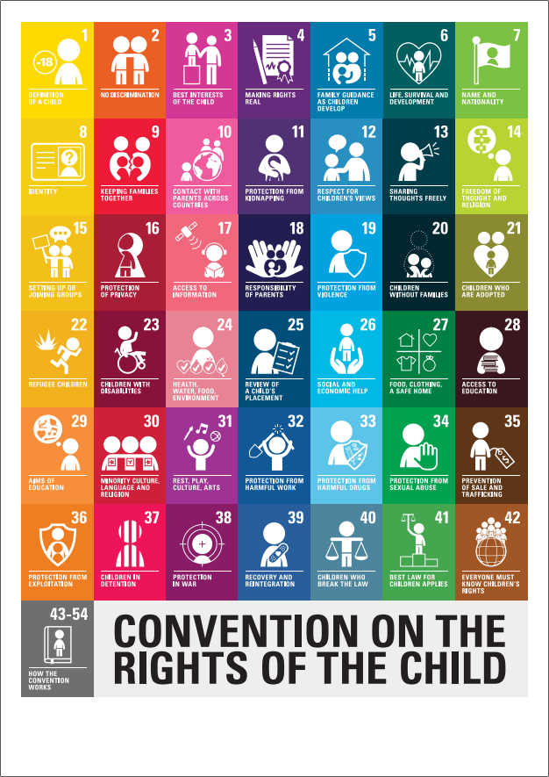
UN Convention on the Rights of the Child
Adopted by the United Nations General Assembly in 1989
Most ratified human rights treaty in the world – legally binding in 196 States parties (including Taiwan, Palestine)
Definition of a child (Art 1)
Right to health (ART 24)
Right to survival and development (art 6)
Right to Non-Discrimination (Art 2)
The best interests of the Child (art 3(1))
right of both parents in care and upbringing of child (art 18)
Right of extended family and community in the upbringing of the child (arts 5 and 20)
Right of children to have their evolving capacities recognized in decision-making (art 5)
Varadan S, Sirinam S, Limkittikul K, Cheah PY. The proxy dilemma: Informed consent in paediatric clinical research - a case study of Thailand. Dev World Bioeth. 2022

Slide 29
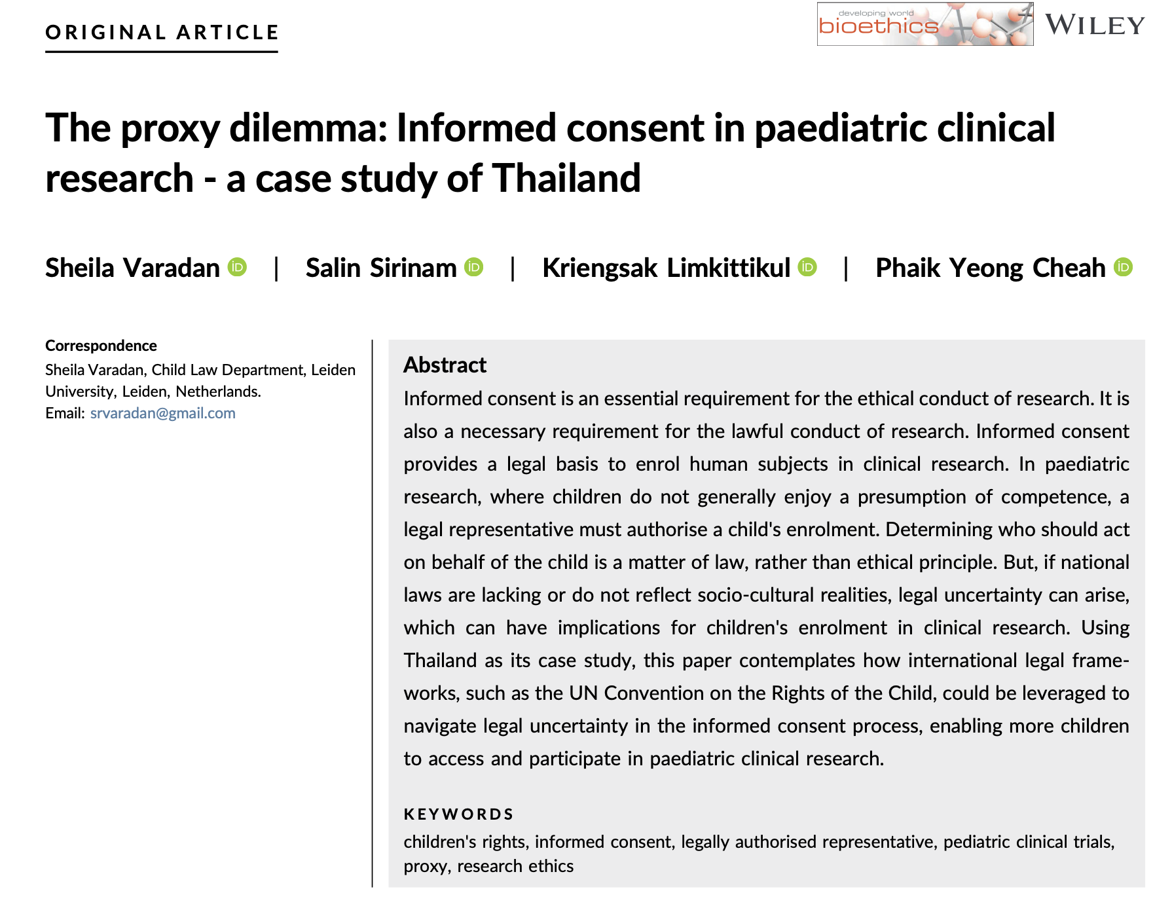

Slide 30
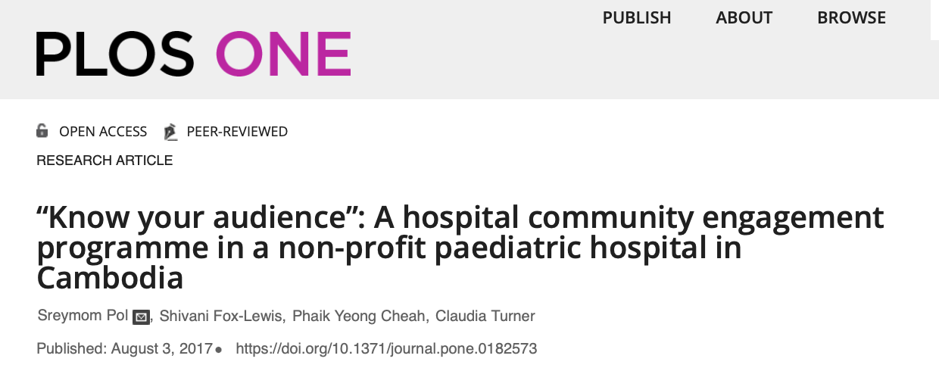

Slide 31
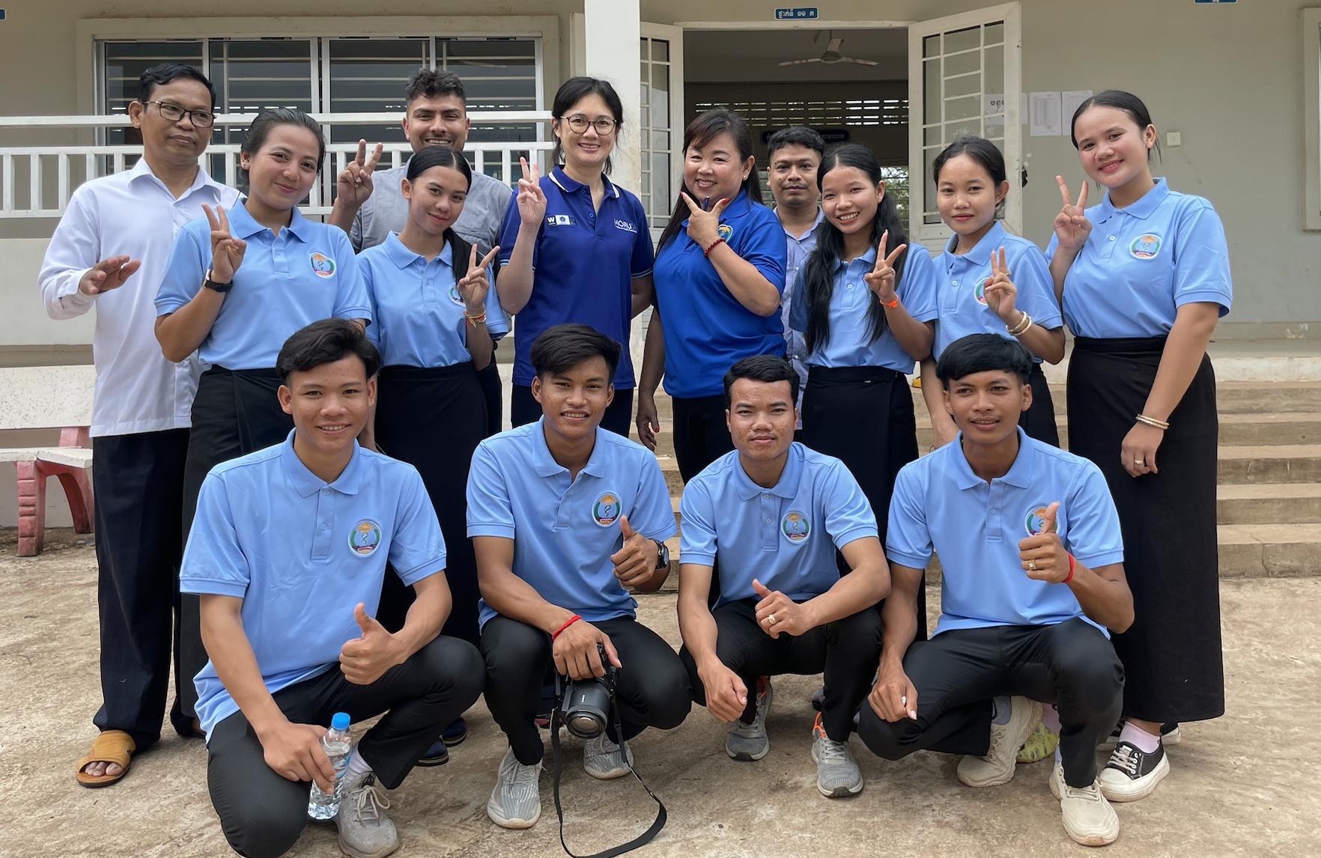
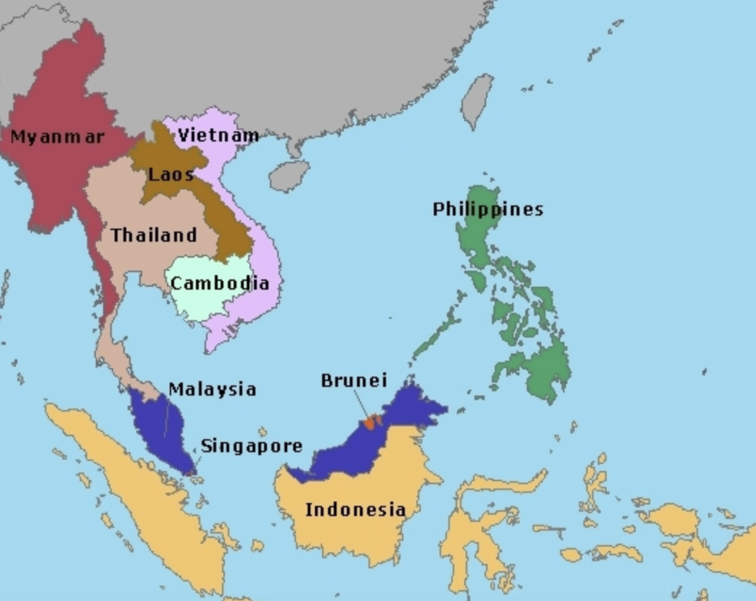
Young Persons Advisory Board – Siem Pang, Cambodia

Slide 32
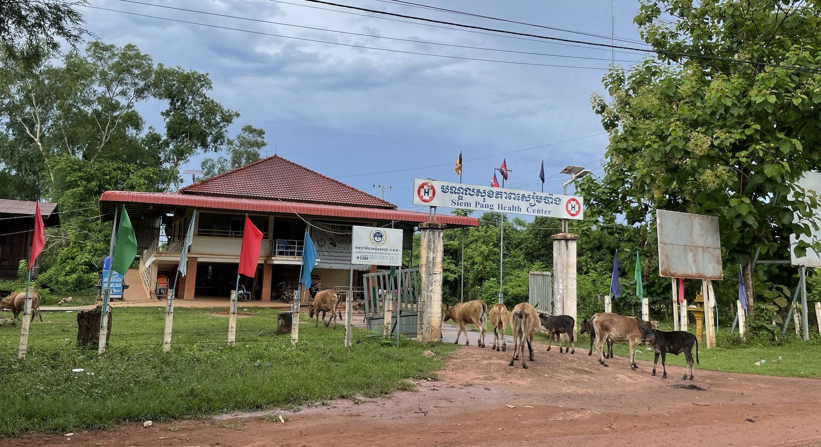
Twitter: phaikyeong
Email: phaikyeong@tropmedres.ac

